Slide 1
Time Series forecasting part v

Slide 2
Exponential smoothing forecast

Slide 3
Forecast by Average
Using mean of all past observations – easiest, intuitive, naïve
Naturally does not work well!!
Can this scheme be modified to get useful forecasts?

Slide 4
Exponential Smoothing
Weighted averages of past observations
Weights decaying as observations get older
Practically speaking, only the recent observations matter
One or more parameters control how fast the weights decay
These parameters have values between 0 and 1

Slide 5
Exponential Smoothing
Decreasing weight given
to older observations

Slide 6
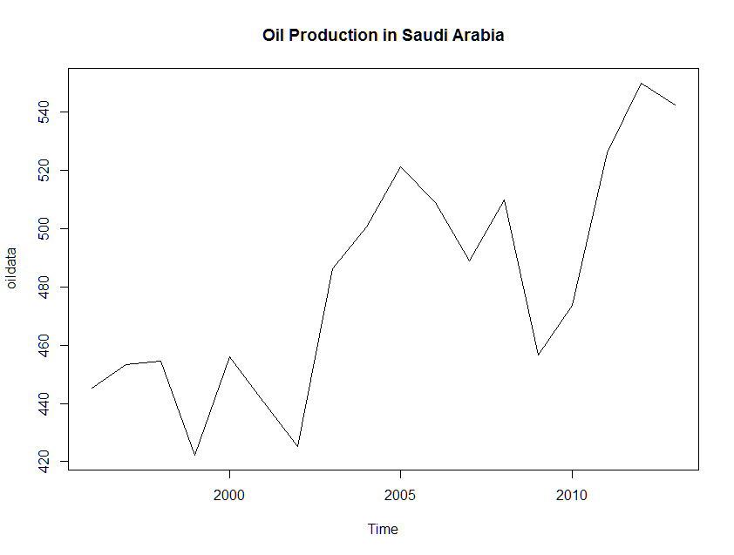
Simple Exponential (SES)
If the time series neither has a pronounced trend nor seasonality: Almost non-available!

Slide 7
Caselet IV: Oil Production
Data is yearly and hence has no seasonality
There is no perceptible trend although in recent years the production shows an increase
Library(fpp2)
fcoil <- ses(oildata, h=3)
Smoothing parameter α is estimated
Forecast given for 3 future periods

Slide 8
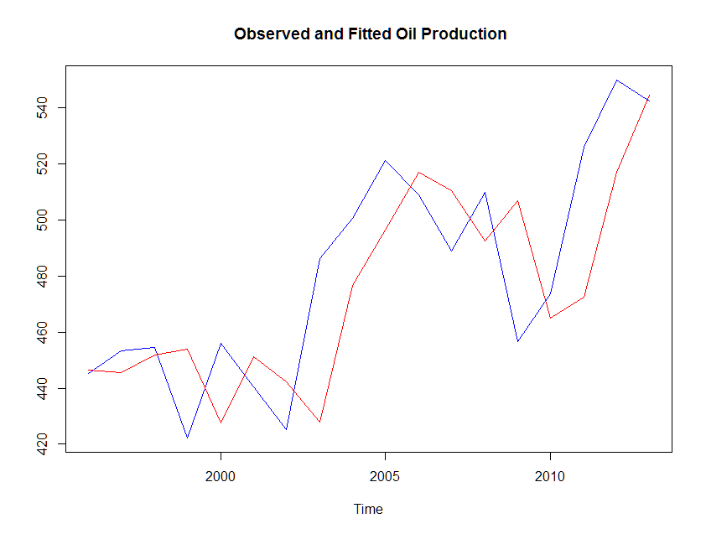
Caselet IV: Oil Production
Actual
MAPE = 4%
Forecast
α = 0.83

Slide 9
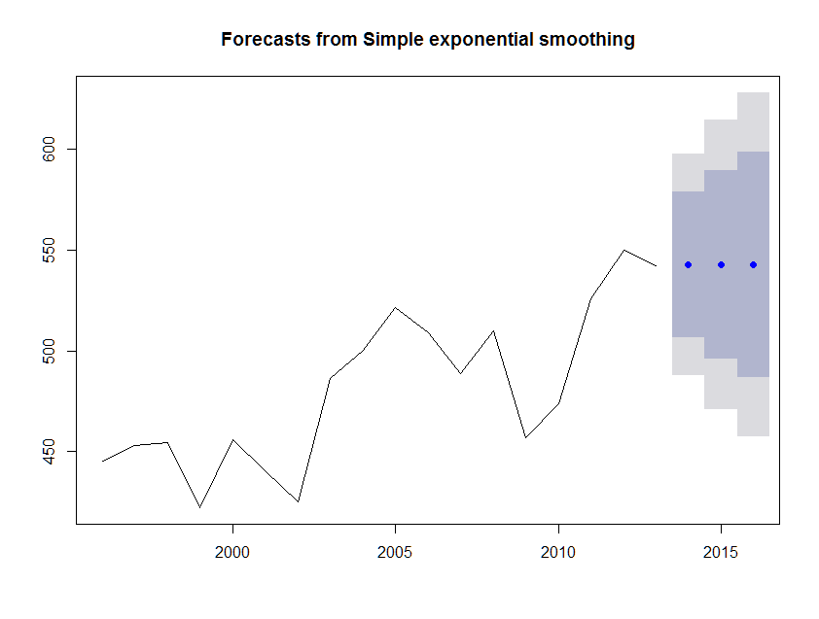
Caselet IV: Oil Production
Forecasts are constant!
Large prediction intervals
indicate considerable uncertainty
Forecast 542.68 for all future time points
Conclusion: Not a good forecast method even though MAPE is small

Slide 10
Exponential Smoothing
Performance of the smoothing parameter α controls performance of the method
If α is closer to 1, forecasts follow the actual observations more closely
If α is closer to 0, forecasts are farther from the actual observations and the line is smooth

Slide 11
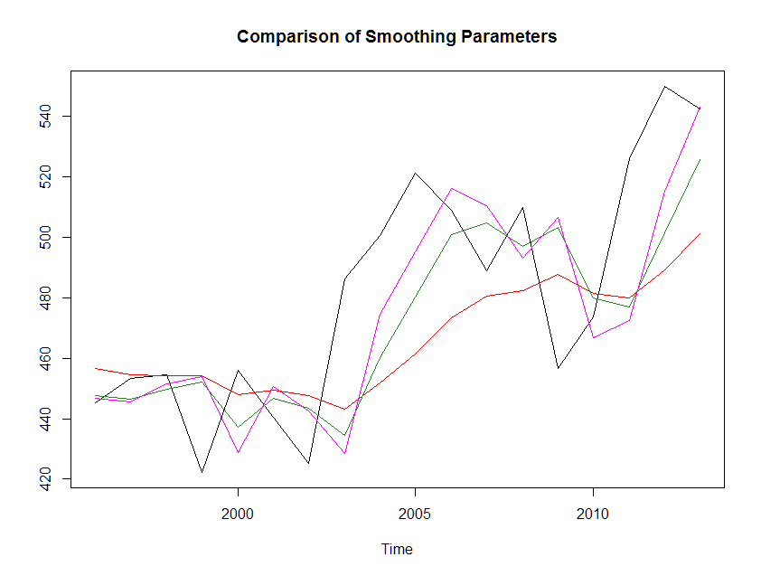
Exponential Smoothing
α=0.8
Actual
α=0.2
α=0.5

Slide 12
Double Exponential
Applicable when data has Trend but no seasonality
An extension of SES
Two separate components are considered: Level and Trend
Level is the local mean
One smoothing parameter α corresponds to the level series
A second smoothing parameter β corresponds to the trend series
Also known as Holt model

Slide 13
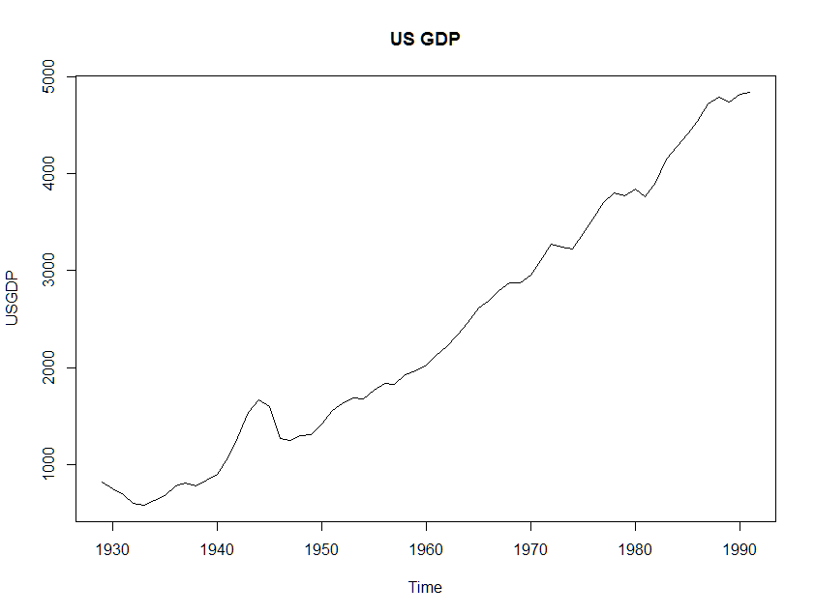
Caselet V: US GDP
Trend Series

Slide 14
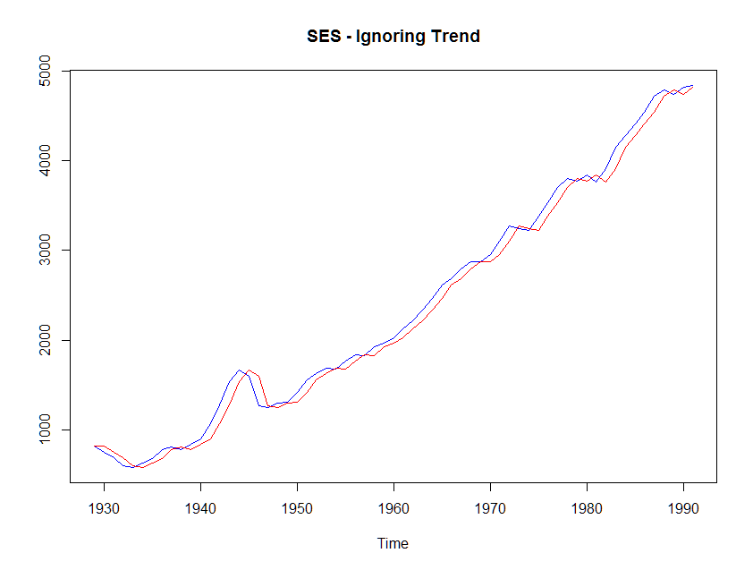
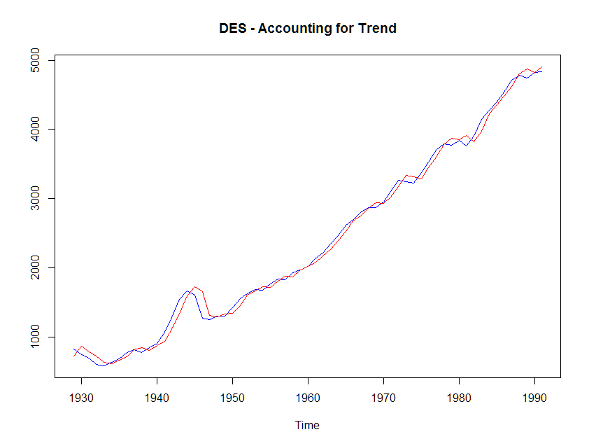
Caselet V: US GDP
α=0.99
β=0.05
α=0.99
MAPE=5%
MAPE=4.5%

Slide 15
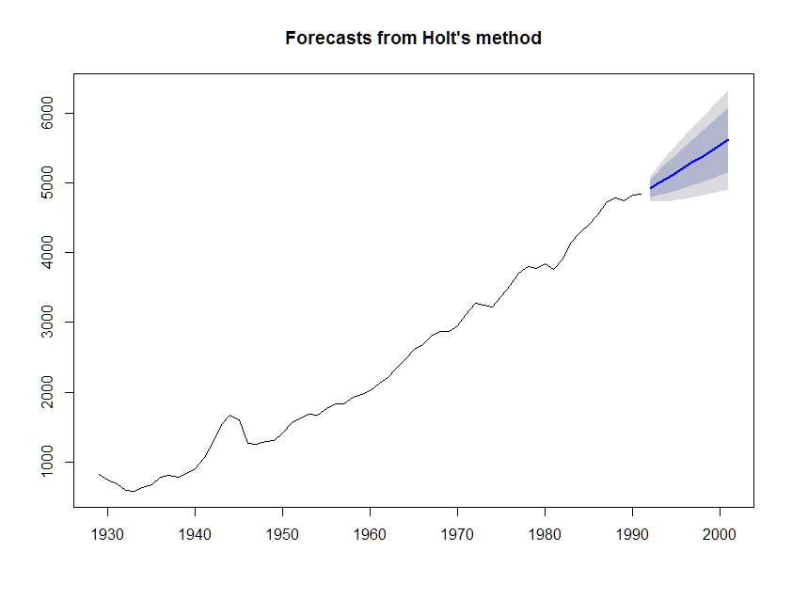
Caselet V: US GDP

Slide 16
Caselet V: US GDP
Year | Forecast GDP
1993 | 4912.776
1994 | 4990.546
1995 | 5068.316
1996 | 5146.085
1997 | 5223.855
1998 | 5301.624
1999 | 5379.394
2000 | 5457.163
2001 | 5534.933
2002 | 5612.702
Prediction intervals are narrower, implying better reliability of the estimates

Slide 17
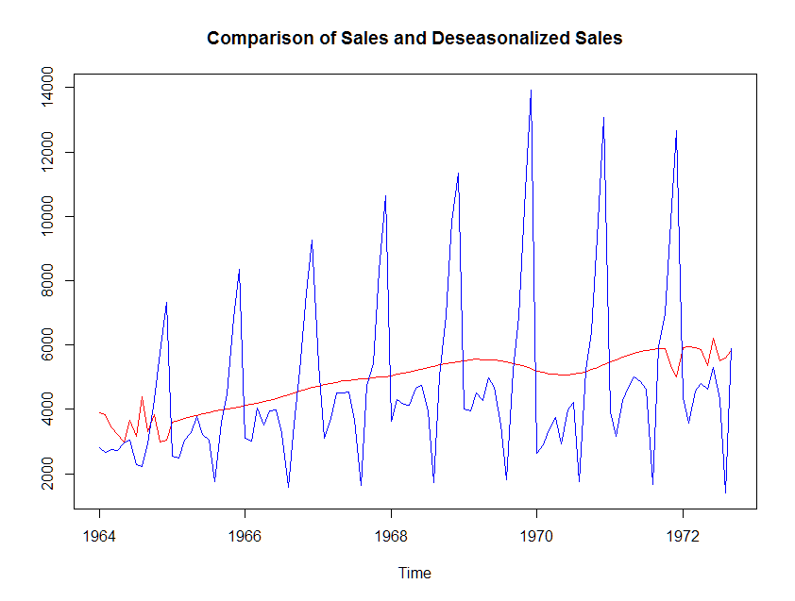
Caselet VI: Champagne Sales
Observations from decomposition:
Additive seasonality
Practically there is no effect of any YOY movement
The changes we see are almost all due to monthly fluctuations

Slide 18
Exponential Smoothing with Seasonality: Holt-Winters’ Model
Because Seasonality can be additive or multiplicative, HW model can be additive or multiplicative
Simultaneously smooths the level, trend and seasonality
Three separate smoothing parameters
α: Smooths level; 0 < α < 1
β: Smooths trend; 0 < β < 1
γ : Smooths seasonality; 0 < γ < 1

Slide 19
Caselet VI: Champagne Sales
Setting up the forecast problem
Data is from 1964 Jan – 1973 Sep
Keep last 15 months as Test data
Champ1 <- window(Champagne, start=c(1964,1), end=c(1970,12))
ChampHO <- window(Champagne, start=c(1971,1), end=c(1972,9))
Fit a Holt-Winters’ model with additive seasonality
Champ.fc <- hw(Champ1, h=21)

Slide 20
Caselet VI: Champagne Sales
Model Estimates
Smoothing parameters:
alpha = 0.0842
beta = 1e-04
gamma = 0.7608
Smoothing parameter for trend (β) almost 0 corroborates well with insignificant YOY movement
Smoothing parameter for seasonality(γ) fairly high that almost all fluctuations are due to seasonality

Slide 21
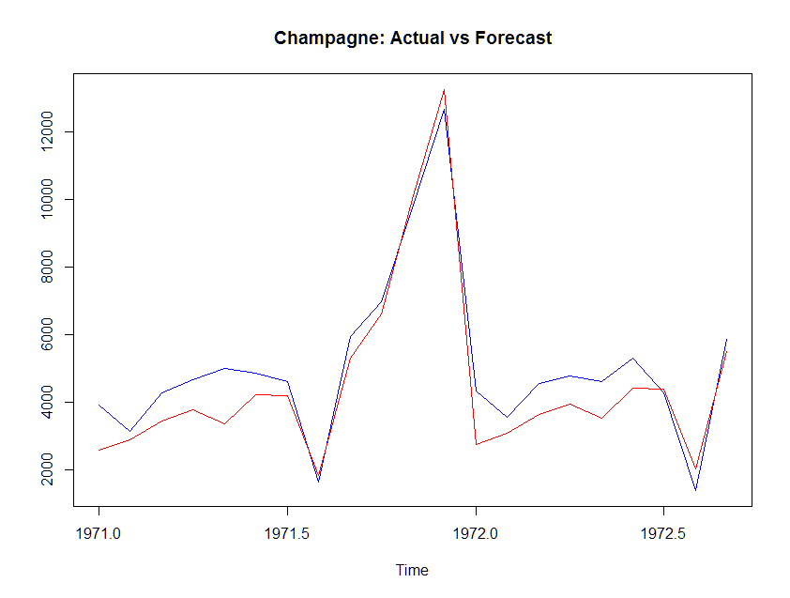
Caselet VI: Champagne Sales
High sales volume forecasts
Are close but not low sales
Volume months
MAPE=16.7%

Slide 22
Caselet VI: Champagne Sales
Since MAPE on the test period is fairly high try an alternative model
Use Forecast by Decomposition
Champ1.stl <- stl(Champ1, s.window = 5)
fcst.Champ1.stl <- forecast(Champ1.stl, method="rwdrift", h=21)
The method that gives lower MAPE is used for final forecast

Slide 23
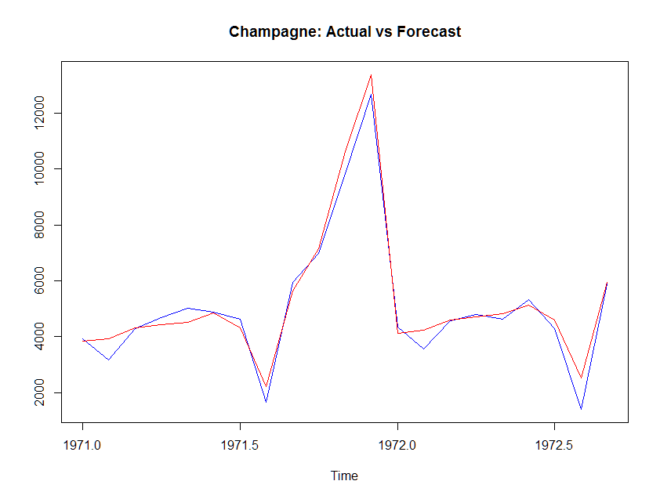
Caselet VI: Champagne Sales
High sales volume forecasts
as well as low sales volume
months
MAPE=10.6%

Slide 24
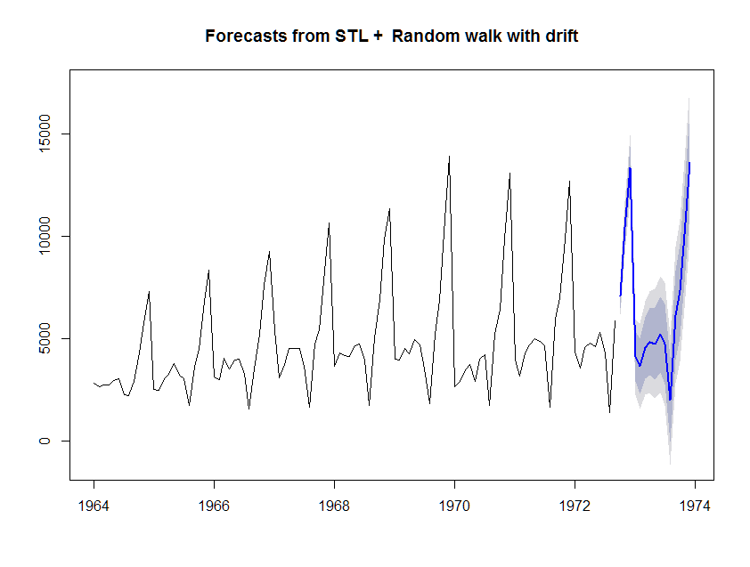
Caselet VI: Champagne Sales
Forecast by Decomposition method is the winner
High sales volume forecasts more reliable as predictions intervals are narrower

Slide 25
Caselet VI: Champagne Sales
How different would be the forecasts by the two methods?
 | Forecasts
 | Decomposition | Holt-Winters
1972-10 | 7080.126 | 7097.209
1972-11 | 10401.137 | 10195.157
1972-12 | 13346.817 | 13092.011
1973-01 | 4122.06 | 4392.767
1973-02 | 3649.603 | 3732.451
1973-03 | 4549.213 | 4697.317
1973-04 | 4837.658 | 4943.076
1973-05 | 4755.214 | 4872.979
1973-06 | 5198.103 | 5358.375
1973-07 | 4743.014 | 4632.006
1973-08 | 2016.786 | 1839.067
1973-09 | 6127.546 | 6136.61
1973-10 | 7330.672 | 7329.65
1973-11 | 10651.684 | 10427.597
1973-12 | 13597.363 | 13324.451
Overall difference about 3%

Slide 26
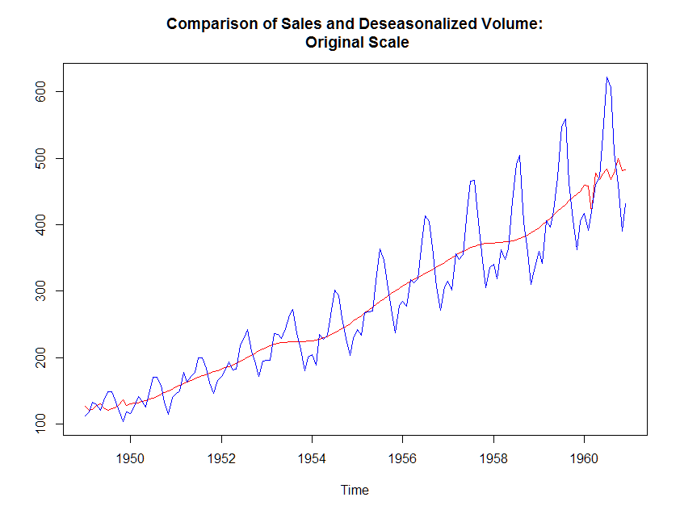
Caselet VII: Passenger Volume
Significant trend
and
seasonality both

Slide 27
Caselet VII: Passenger Volume
Setting up the forecast problem
Data is from 1949 Jan – 1960 Dec
Keep last 24 months as Test data
AirPax1 <- window(AirPassengers, start=c(1949,1), end=c(1958,12))
AirPaxHO <- window(AirPassengers, start=c(1959,1), end=c(1960,12))
Fit a Holt-Winters’ model with multiplicative seasonality
AirPax.fc <- hw(AirPax1, seasonal="m", h=24)

Slide 28
Caselet VII: Passenger Volume
Model Estimates
Smoothing parameters:
alpha = 0.3515
beta = 0.0147
gamma = 0.6481
Smoothing parameter for trend (β) small compared to other parameters
Indicates almost a straight line trend
Smoothing parameter for seasonality(γ) fairly high

Slide 29
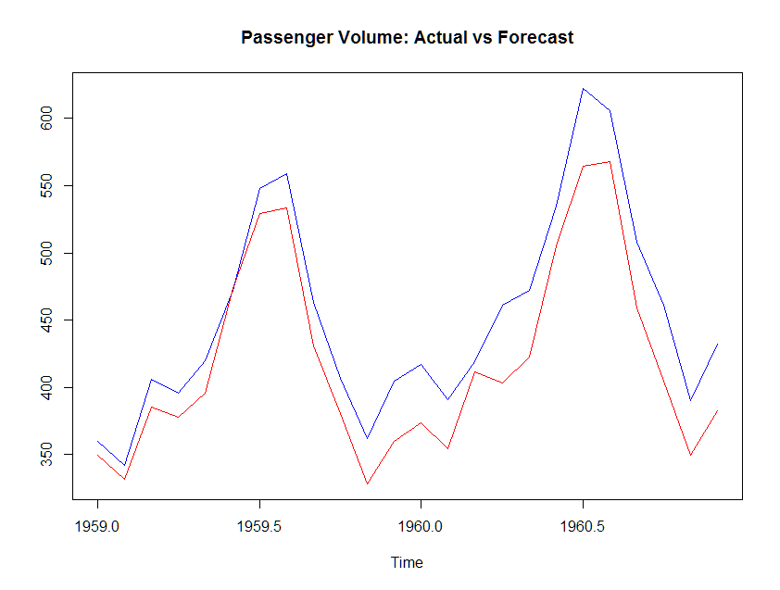
Caselet VII: Passenger Volume
Forecast values show
small bias
MAPE=7%

Slide 30
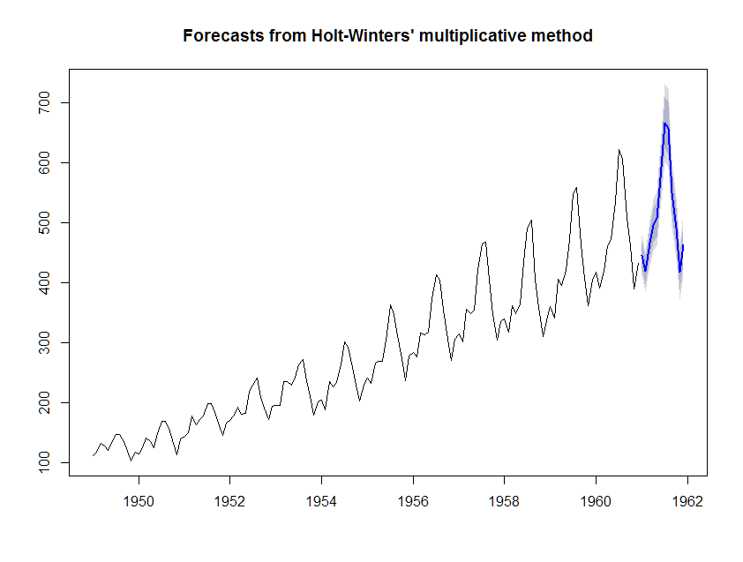
Caselet VII: Passenger Volume
Since MAPE is acceptable, use the same model for forecast for next year

Slide 31
Caselet VII: Passenger Volume
Possible steps for model improvement
Is it necessary to use data from the beginning, i.e. from 1949?
How much does the model and MAPE change if, instead of 24 months, we have last 12 months as the test period?
For decomposition, we used a log transformation on the data. If the same transformation is used and an additive seasonality model is fit, would it change anything?

Slide 32
Next Step: Alternative Approach
In the next lesson we undertake another forecast method based on regression approach
Thank You

